Slide 1

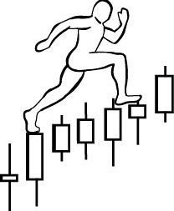
Homework #4:
due on February 4th , 2019
1. Exercise #1: Labeling - MSFT
Assignment: Label trading ranges with Wyckoff Phases and Events, and CHoCH
www.WyckoffAnalytics.com Copyright © 2018 Wyckoff Associates, LLC. All Rights Reserved.

Slide 2
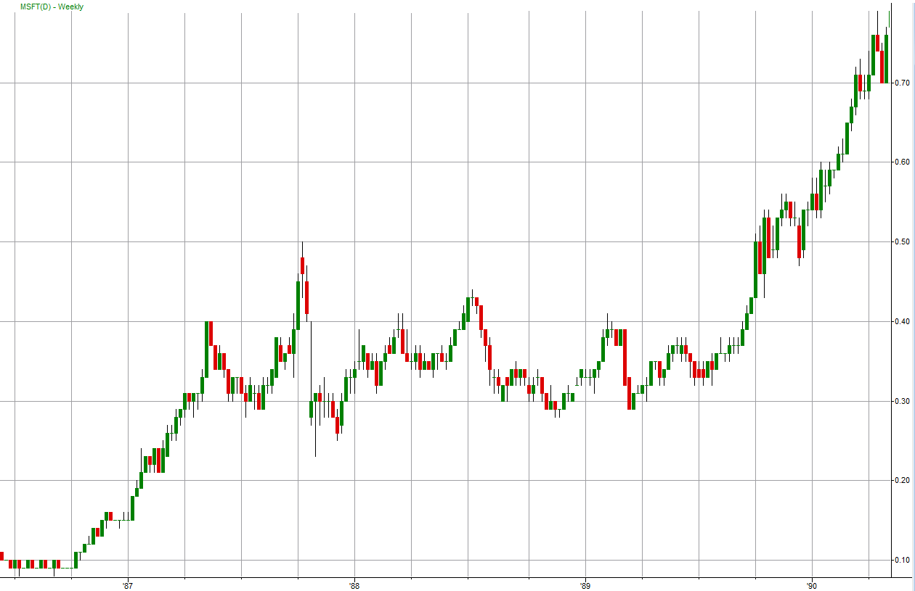
Exercise: MSFT - 1
www.WyckoffAnalytics.com Copyright © 2019 Wyckoff Associates, LLC. All Rights Reserved.

Slide 3
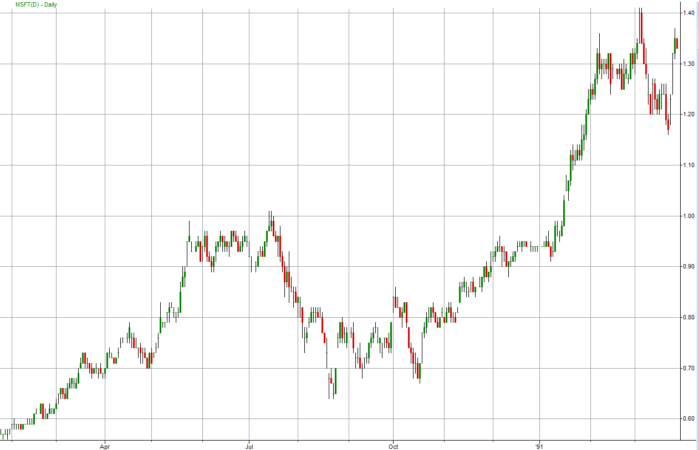
Exercise: MSFT - 2
www.WyckoffAnalytics.com Copyright © 2019 Wyckoff Associates, LLC. All Rights Reserved.

Slide 4
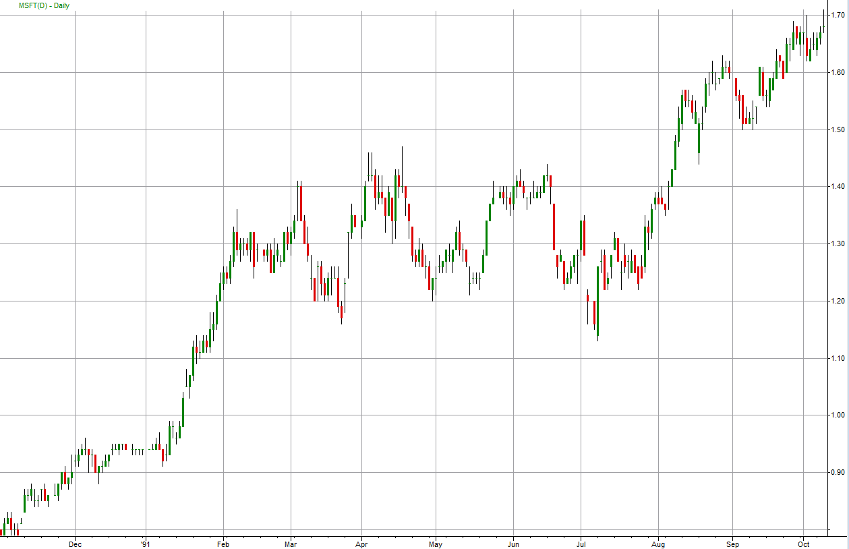
Exercise: MSFT - 3
www.WyckoffAnalytics.com Copyright © 2019 Wyckoff Associates, LLC. All Rights Reserved.

Slide 5
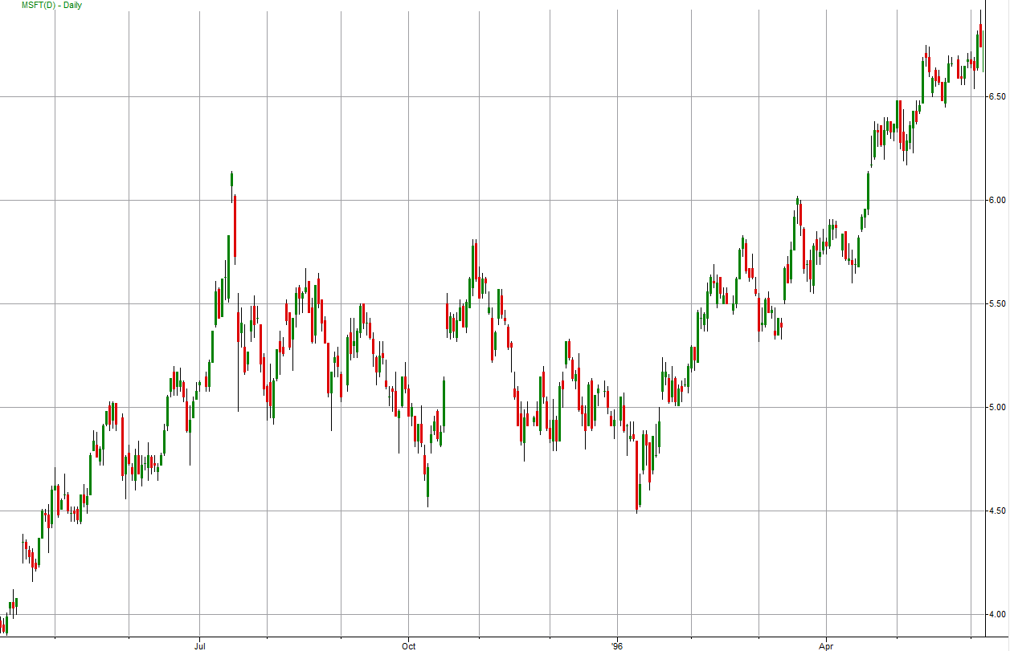
Exercise: MSFT - 4
www.WyckoffAnalytics.com Copyright © 2019 Wyckoff Associates, LLC. All Rights Reserved.

Slide 6
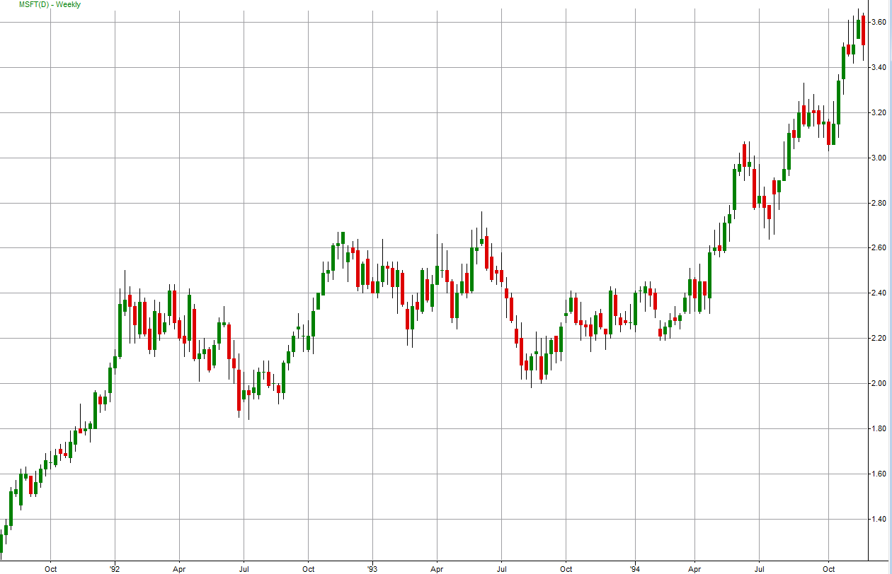
Exercise: MSFT - 5
www.WyckoffAnalytics.com Copyright © 2019 Wyckoff Associates, LLC. All Rights Reserved.

Slide 7
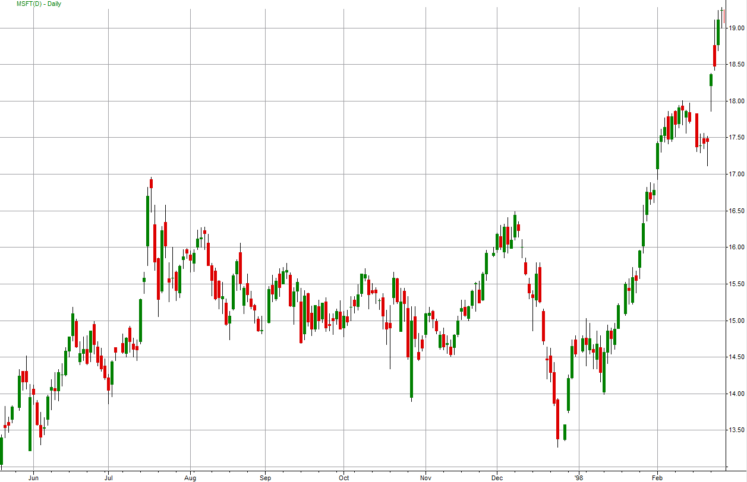
Exercise: MSFT - 6
www.WyckoffAnalytics.com Copyright © 2019 Wyckoff Associates, LLC. All Rights Reserved.

Slide 8
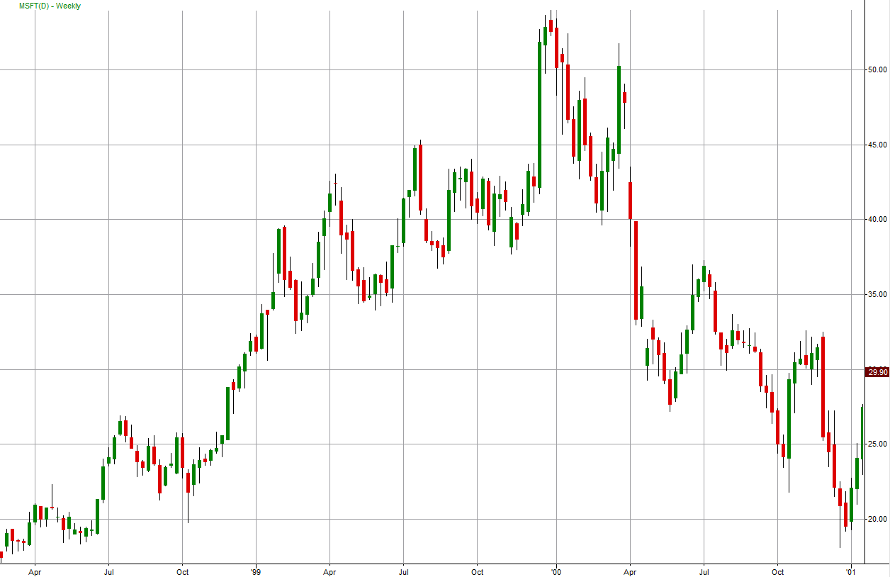
Exercise: MSFT - 7
www.WyckoffAnalytics.com Copyright © 2019 Wyckoff Associates, LLC. All Rights Reserved.

Slide 9
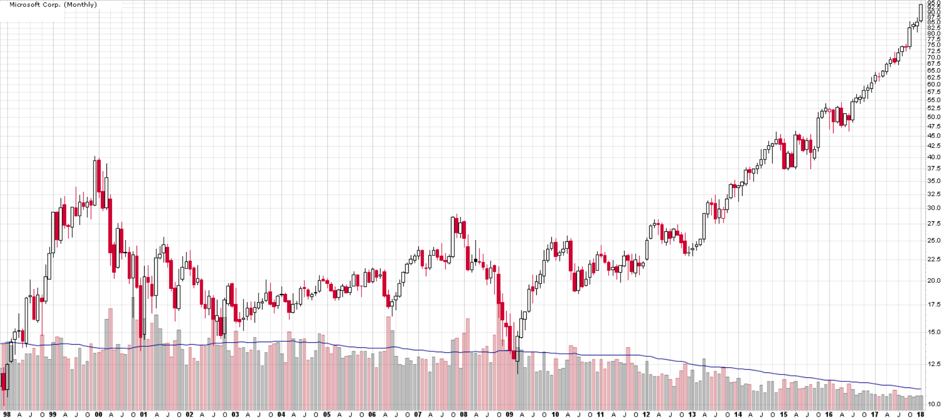
Exercise: MSFT - 8
www.WyckoffAnalytics.com Copyright © 2019 Wyckoff Associates, LLC. All Rights Reserved.

Slide 10
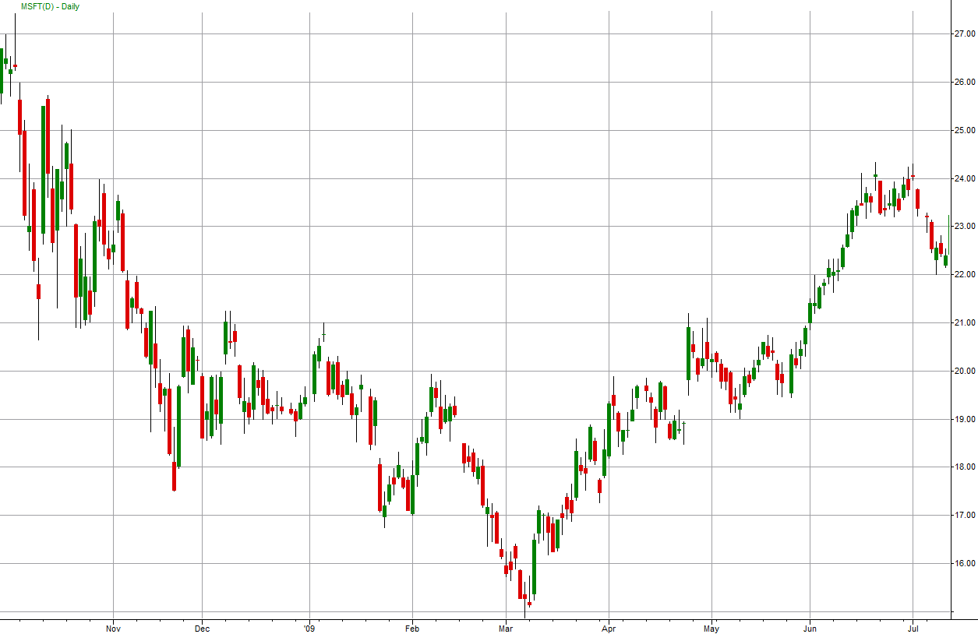
Exercise: MSFT – 9
www.WyckoffAnalytics.com Copyright © 2019 Wyckoff Associates, LLC. All Rights Reserved.

